Slide 1
Satellite Safety and Circularizing Orbits: A Study in Simplifying Models
Anthony Ko

Slide 2
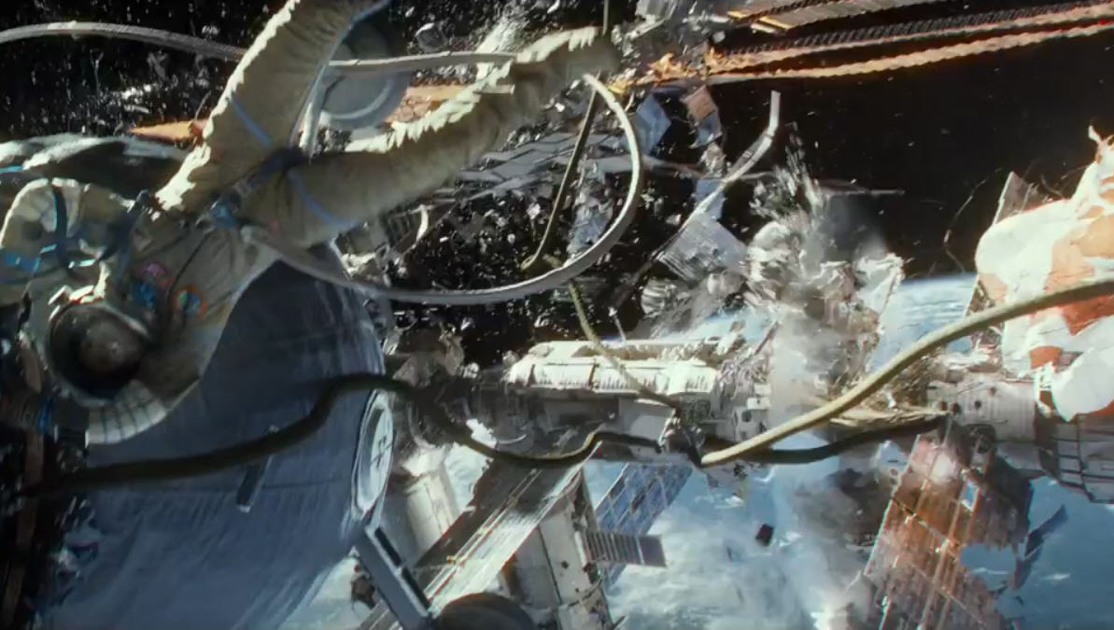
Motivation (Why this is important):
Despite popular belief, a significant amount of satellites experience drag, which causes them to fall to Earth and gain eccentricity
Satellites in space are in a delicate balance, their proper orbits must be maintained for several reasons:
A satellite is designed for a mission
Satellites are expensive
Safety of satellites in orbit are dependent on the safety of others
Kessler Syndrome as portrayed by the film Gravity (2013).
This is a bad thing.

Slide 3
Mathematical Background (Why orbital mechanics models are complicated):
Orbits are most simply described as one object moving about another due to a central force (in our case, gravity)
Quite complicated in Cartesian coordinates:
$F_{x}=\left(\frac{−GMm}{x^{2}+y^{2}}\right)\left(\frac{x}{\sqrt{x^{2}+y^{2}}}\right)$ $F_{y}=\left(\frac{−GMm}{x^{2}+y^{2}}\right)\left(\frac{y}{\sqrt{x^{2}+y^{2}}}\right)$ where:
G is the gravitational constant
M is the mass of Earth
m is the mass of the satellite
x and y are the distance from the satellite to the center of Earth
F is the force of gravity
Analyzing an orbit using position and velocities is messy as it forces us to consider the ODE of four variables (x, y, v_{x}, and v_{y}) that all depend on each other
Energy: $E= \frac{1}{2}m{(v}_{x}^{2}+v_{y}^{2})− \frac{GMm}{\sqrt{x^{2}+y^{2}}}$ and angular momentum: $L=r×mv$ both necessary conserved quantities used for modeling, do not appear readily in these mechanics
Adding the force of drag into the mechanics stops the quantities from being conserved

Slide 4
Modeling Assumptions (How can we simplify things):
2-Dimensionality: Any orbit’s reference frame can be rotated such that it lies in a plane
This means only x and y coordinates in Cartesian coordinates, and a radial and a singular angular component in polar coordinates
No air resistance:
~0.2m/s velocity loss per orbit due to drag, typical orbit velocity ~7000m/s, velocity change per orbit is negligible
Allows us to assume energy conservation and angular momentum conservation (very useful later on)
Mass of Earth >> Mass of Satellite
Consider Satellite moving around a stationary Earth, reduced mass of the system is dominated by Earth
Impulsive thrust
Propellant rockets used on many satellites can impart over 1000m/s of delta-v in the order of minutes
Velocity can change nearly instantaneously

Slide 5
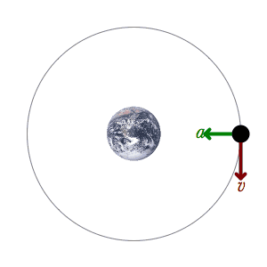
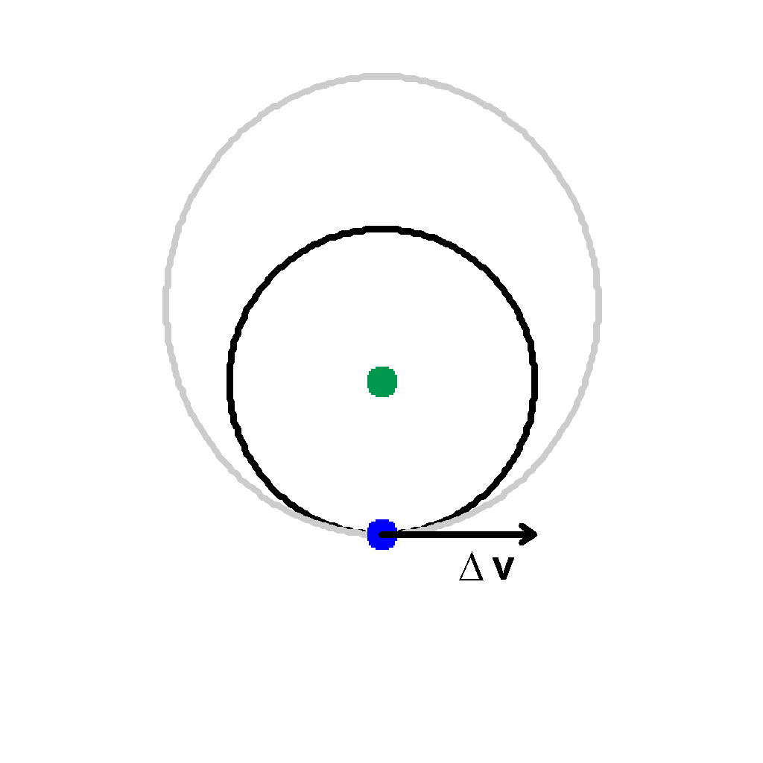
Perpendicular Orbits (Thrust Points, what are they?):
In an elliptical orbit, the direction of the velocity is not always perpendicular to the force of gravity (as in a circular orbit)
The centripetal force from the velocity is equal and opposite to the central force
These are also the points where the radius of the orbit is not changing
Want to find points in elliptic orbit where velocity is perpendicular to force
Impulsive thrust at these points can create circular orbit (we have the right direction, we just need the right velocity)

Slide 6
Perpendicular Orbits (Thrust Points, where are they?):
We will use our assumption of energy conservation to create a simple model that does not need us to try consider the
$${Energy}_{total}=Kinetic Energy+Potential Energy$$
Using polar coordinates:
$$E_{total}=\frac{1}{2}m{\dot{r}}^{2}+\frac{1}{2}mr^{2}{\dot{φ}}^{2}+U\left(r\right)$$
Substituting in angular momentum L, in the second term (getting rid of $\dot{φ}$ dependence) and using gravitational potential energy, then solving for $\dot{r}$:
$$\dot{r}=\sqrt{\frac{2}{m}}\sqrt{E_{total}+\frac{GmM}{r}−\frac{L^{2}}{2mr^{2}} }$$
This is a convenient formulation for $\dot{r}$ as all the variables are constant, except for r. We look for the point where $\dot{r}$ is zero as at that point, we know that we are only moving radially. Since central force is radial, the force is perpendicular to the velocity.

Slide 7
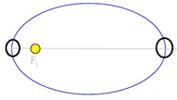
Perpendicular Orbits (Building the Model):
Initial Conditions and ODE Domains:
Kinetic energy must be less than potential energy so as to not escape orbit (thus E_{total} must be negative), also as energy is conserved, the energy must be constant in the domain
L is conserved, so the initial angular momentum is conserved, and constant through the dynamics, thus in the domain of the ODE, L must always be conserved
Considering the $\sqrt{E_{total}+\frac{GmM}{r}−\frac{L^{2}}{2mr^{2}}}$ term in the ODE, we see that underneath the radical, we actually just have kinetic energy, which must be positive, so we know that $\dot{r}$ is always positive
Goals:
Prove the existence of a point where $\dot{r}$ is zero as our post-condition
I was actually unable to prove this model formally, as we do not have support for existential modality in KeYmaeraX.
Geometrically we can see that there are points where this is true (as the radius goes from getting larger to getting smaller

Slide 8
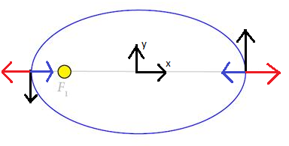
Circularizing
Assume the first model has shown us the existence of the proper thrusting points (perpendicular force with our velocity)
Using impulsive delta-v, we can model the appropriate thrusting as a simple assignment of the correct velocity
The model is trivial, as we can calculate the appropriate velocity for circularization by simple balance of gravitational force and centripetal force to be: $\sqrt{\frac{GM}{r}}$
Red arrows showing direction of centripetal force, blue arrows show direction of gravitational force, black arrows show direction of velocity

Slide 9
Putting it together (“Circle-ness”):
We measure “circle-ness” with eccentricity:$e=\sqrt{1+ \frac{2E_{total}L^{2}}{M{(GMm)}^{2}}}$
0 ≤ e < 1 where 0 is a perfect circle and approaching 1 is max eccentricity while remaining in orbit
Again assuming the outcomes of the previous models
We know $\dot{r}$ in the total energy equation is zero, thus $E_{total}=\frac{L^{2}}{2mr^{2}}−\frac{GmM}{r}$
Substituting E_{total} in and the appropriate terms for L we can rewrite eccentricity as: $e=\sqrt{1+ \frac{v^{4}mr^{2}}{G^{2}M^{3}}−\frac{2rmv^{2}}{{GM}^{2}}}$
All these terms are constant except v and r
To simplify this we assume that the delta-v from drag always occurs at the same constant r
This model shows that we always are approaching worst case drag as e approaches 1 as v approaches 0
We now have a model where eccentricity is a function of only v

Slide 10
Putting it together (“Circle-ness” model):
We know we are modeling at the same r every time and by conservation of energy, the same point
Instead of using an ODE, we can model this eccentricity with a loop where each iteration the velocity decreases from drag and updates the eccentricity at the same point in each orbit
We bound the possible delta-v from drag to some maximum that is less than our current velocity
The model control predicts the maximum eccentricity that could occur should the max delta-v occur from drag
If greater than our desired eccentricity bound, circularize instantaneously
I was not quite able to prove this, most likely due to some case where: $e\left(v_{updated}\right)<e(v_{maxDrag})$ is not necessarily true
This most likely needs another invariant about relating the two terms under the radical in $e=\sqrt{1+ \frac{v^{4}mr^{2}}{G^{2}M^{3}}−\frac{2rmv^{2}}{{GM}^{2}}}$ to prove this

Slide 11
Conclusion
We break the problem of drag effecting orbits into three simpler models:
1. Finding smart points to circularize orbit
2. Finding the appropriate thrust at these points to circularize
3. Designing the appropriate control to never have a too eccentric orbit
Building off of the previous models, the final model is based on a single variable changing in a single function
We do not need to consider the dynamics of multiple ODEs of multiple variables
Being able to prove all three, shows that the last model is a safe control for maintaining a reasonably circular orbit
While smart simplifications were able to greatly reduce the complexity of these models, some work still needs to be done for a final rigorous proof

